Slide 1
ML Assisted Pipeline Crack Detection
Adam Frost and Brandon Thibodaux

Slide 2
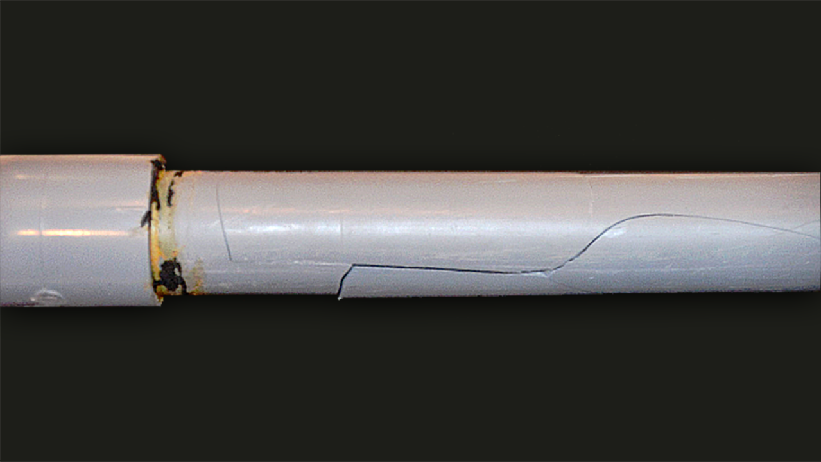
Project Objective
Machine learning assisted pipe crack and anomalies detection

Slide 3
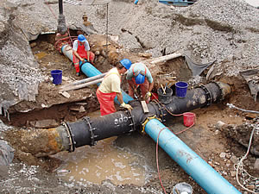
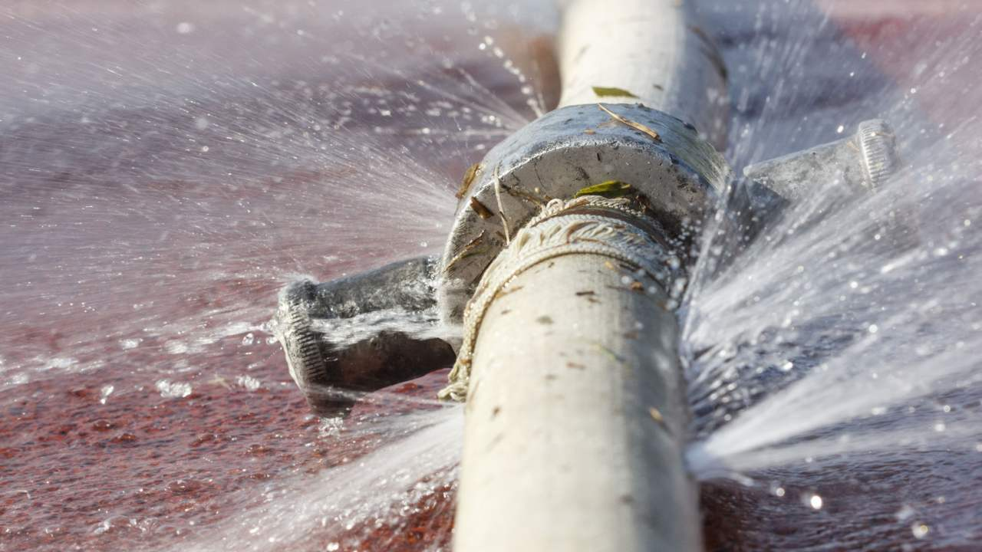
Project Motivation
Automated pipeline inspection
industry/plants
municipal water systems (sewers, water delivery)
oilfields
anywhere pipe is used
Inaccessible/Hazardous locations
24/7 monitoring known trouble spots

Slide 4
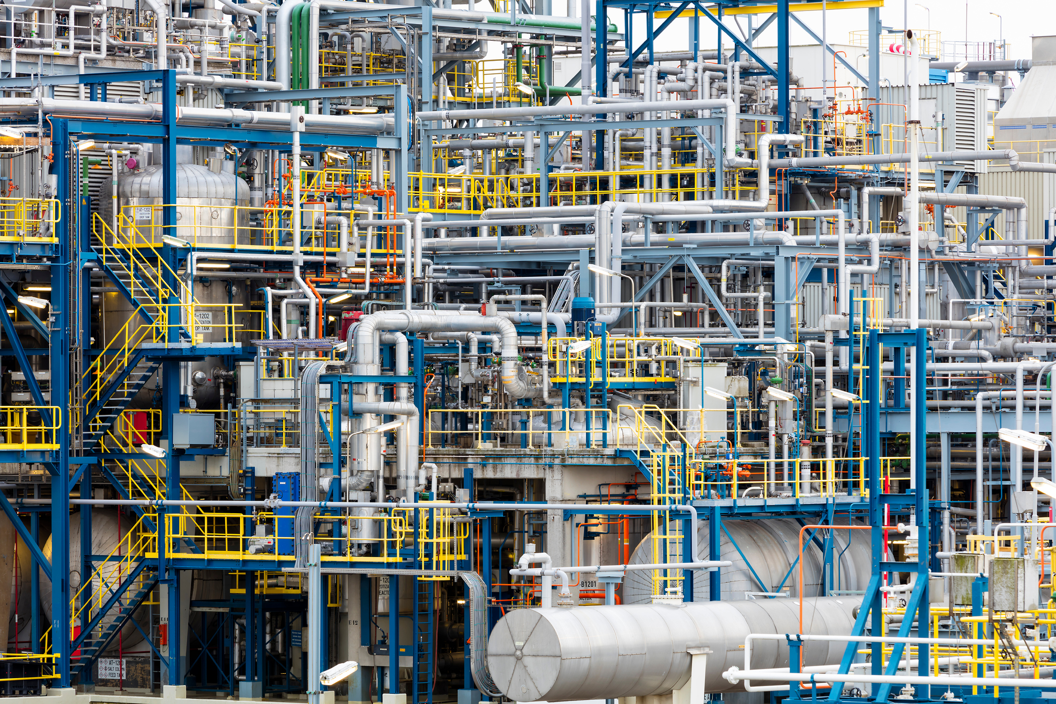

Slide 5
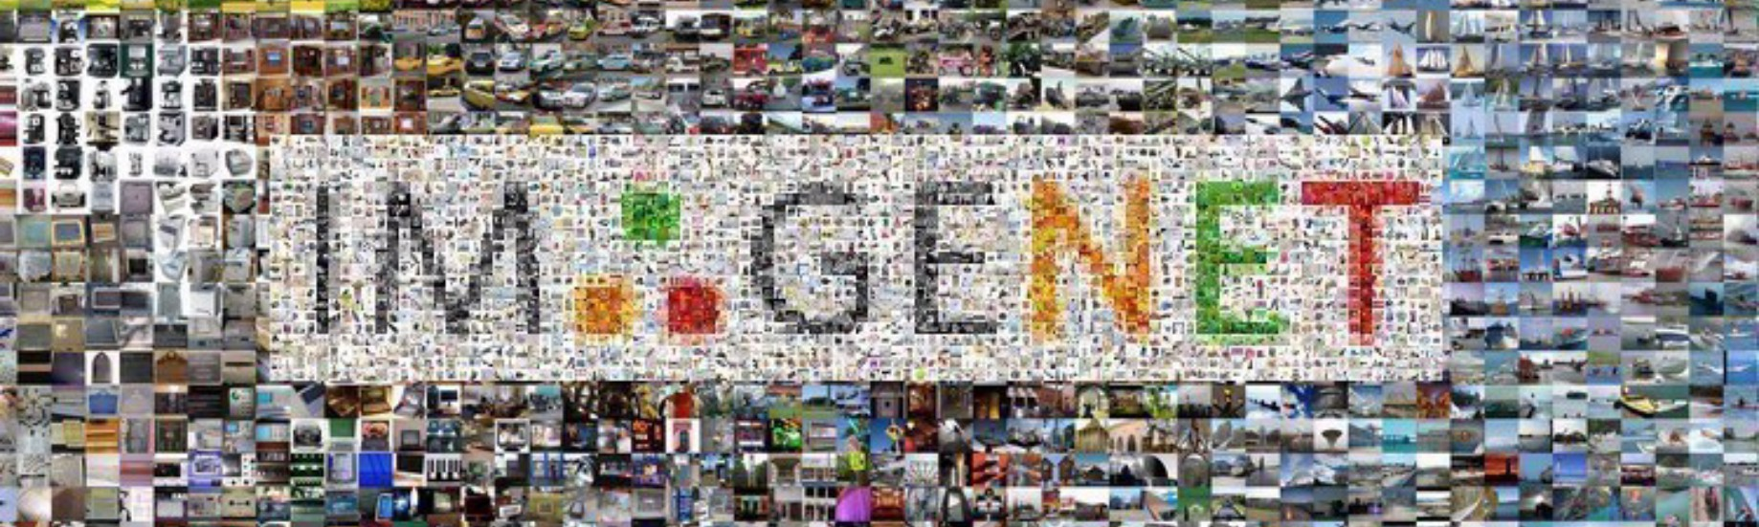
ImageNet
Retrained Inception v3 model
Based on ImageNet dataset until final layer (Our custom data set)
1.2 million training images, 50,000 validation images and 100,000 testing images, 100,000 classifications

Slide 6
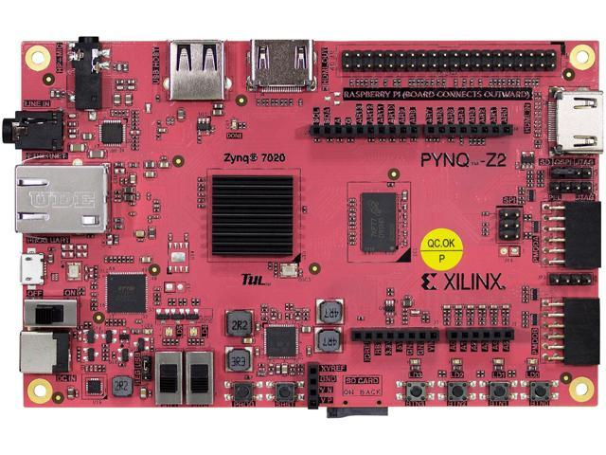
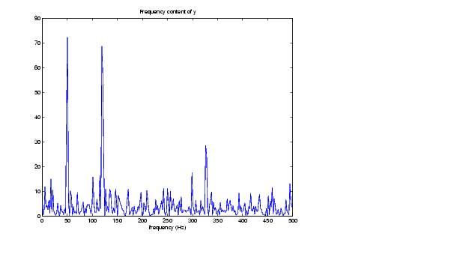
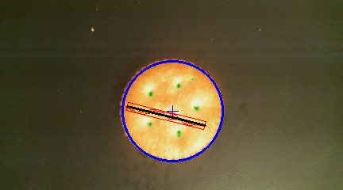
Considered Designs Alternatives
PYNQ
32-bit PS (Processing System)
No TensorFlow overlays for version Z-2
Microphone
Quality needed is expensive
Pi resources already maxed out, no room for audio processing
Building the data set wasn’t feasible
OpenCV
UI - Bandboxing and data overlays on a live preview
Difficult to compile and long build time on Pi
Pi resources already maxed

Slide 7
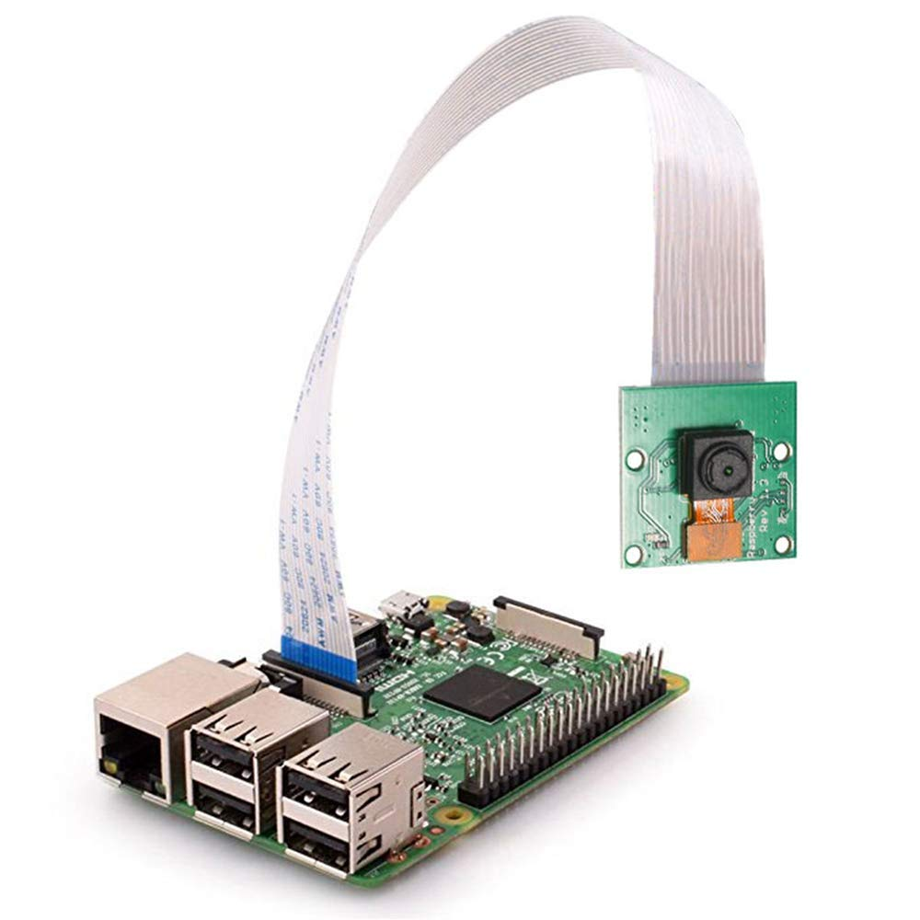



Project Materials
Pi 3b+
Raspbian Linux Distro (Pi)
OmniVision OV5647
Tensorflow 1.13.1-GPU (Desktop Training) (Win10)
CUDA 10.0 (Win10)
cudNN 9.0 (Win10)
Tensorflow 1.13.1-ARM (Pi inference)
Anaconda3 Python Environment Manager
IfranView
PVC Pipe

Slide 8
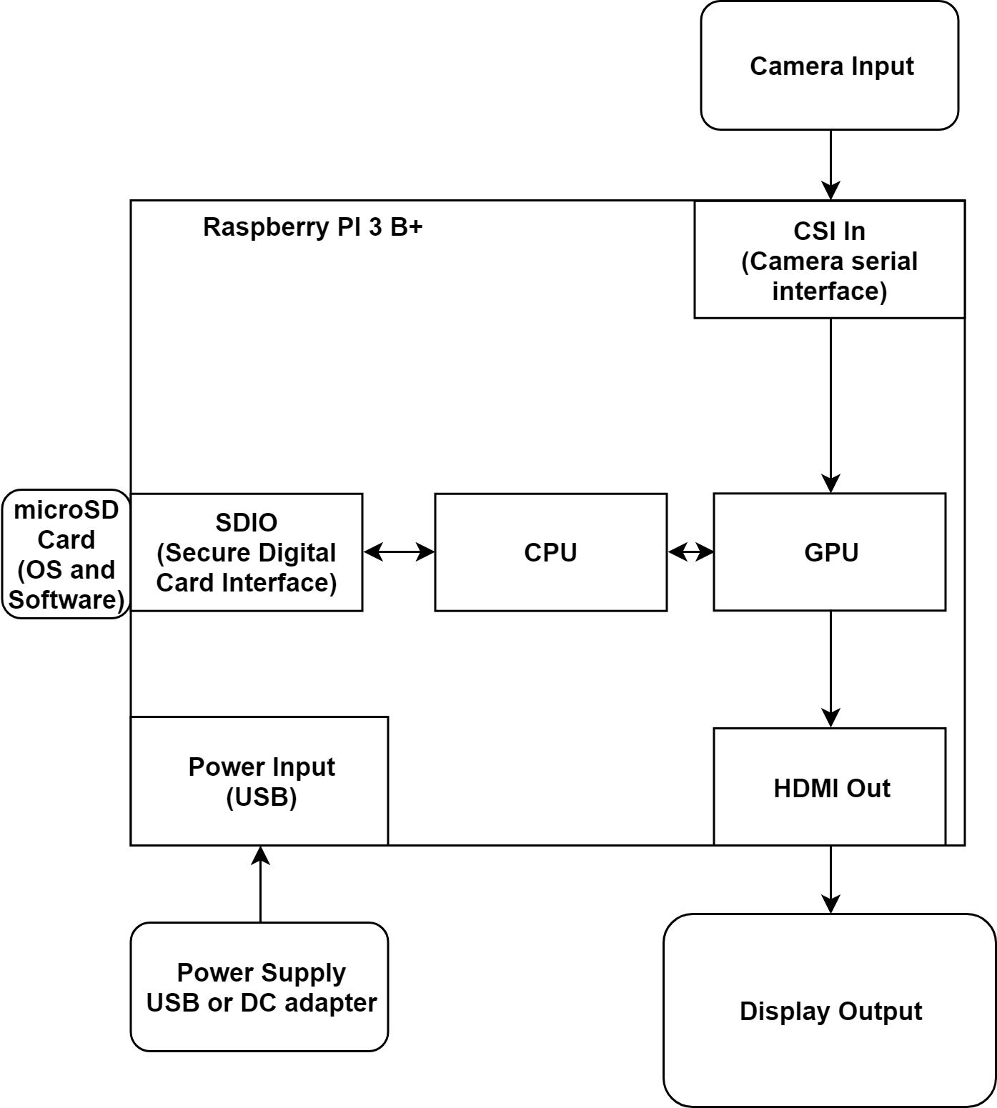
Project Block Diagram

Slide 9
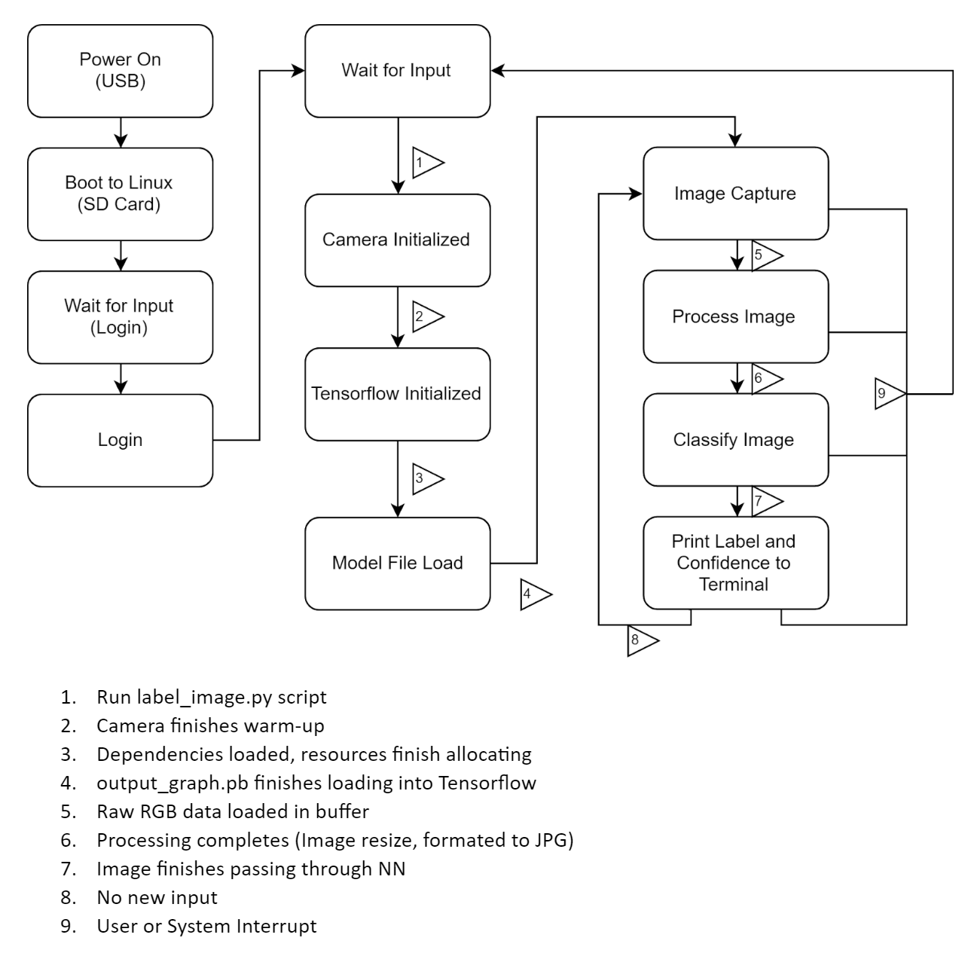
Project State Diagram

Slide 10
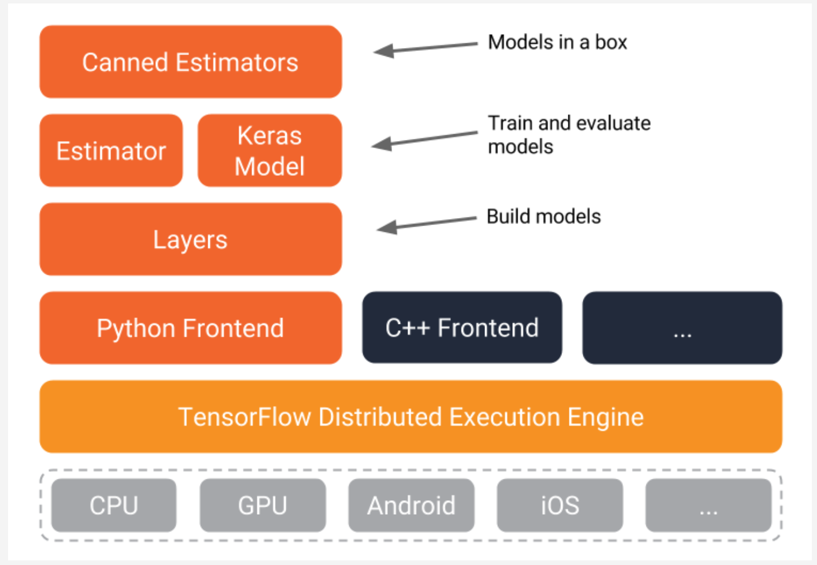
Machine Learning Model
OpenSource platform with tools and libraries for machine learning
Designed to enable state-of-the-art ML development at all levels of interest

Slide 11
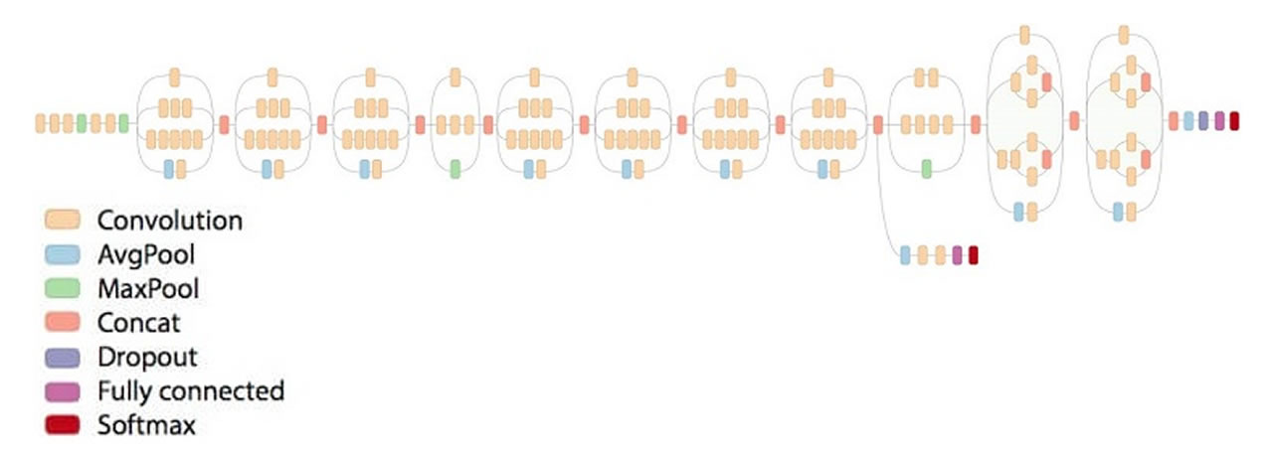
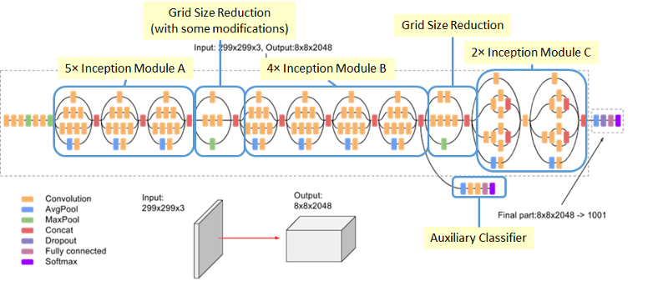
Inception v3
Factorized convolutions to reduce the number of parameters
Applying convolution filters to each input leads to repeatedly applying filters unnecessarily
Filters can be shared across multiple inputs, so less memory and computation needed

Slide 12
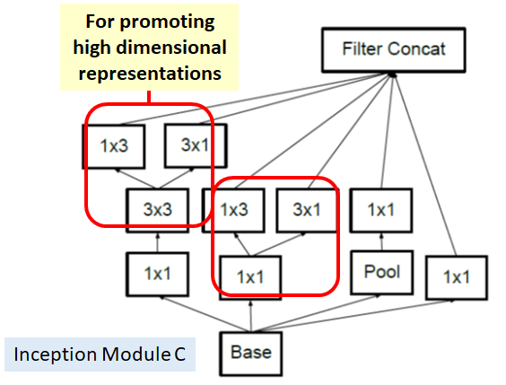
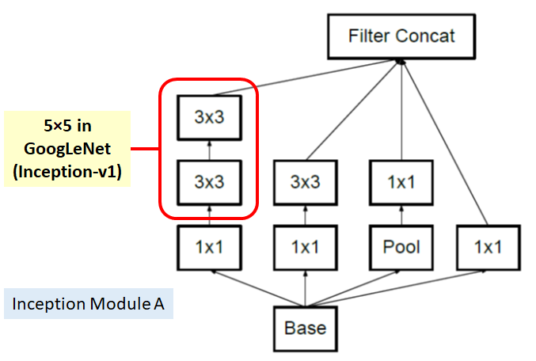
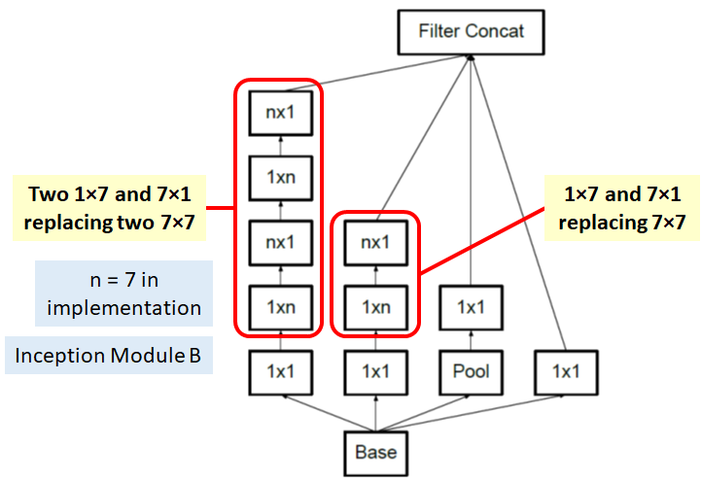
Inception v3
Example: Factorize a 5x5 convolution into two 3x3 convolution operations
A 5x5 convolution is 2.78 times more expensive than a 3x3 convolution.

Slide 13
Future Work
Larger dataset
Increase background variety until NN ignores it
Hardware upgrade:
implement object detection to check for a pipe before crack detection
faster sample and inference rates (~realtime)
UI with live preview, bandboxing, on screen classification and %’s
Better camera, increase image resolution, finer cracks detectable
Automation
Mobility - self-propelled and guided
Map pipeline, crack/damage heatmaps
Other tests
Detect rust/stains and other signs of cracking

Slide 14

Roles
Adam - Inference Deployment, Hardware
Brandon - Dataset Construction, Model Training

Slide 15

Challenges
Software compatibility/interactions
Limited Python knowledge
Limited TensorFlow knowledge
Can ML overcome dirt/staining/paint with a large enough dataset
Integrating more types of pipe (train NN to ignore color/other characteristics, and simply recognize a generic pipe)
Overfitting - small dataset is easy to overtrain

Slide 16
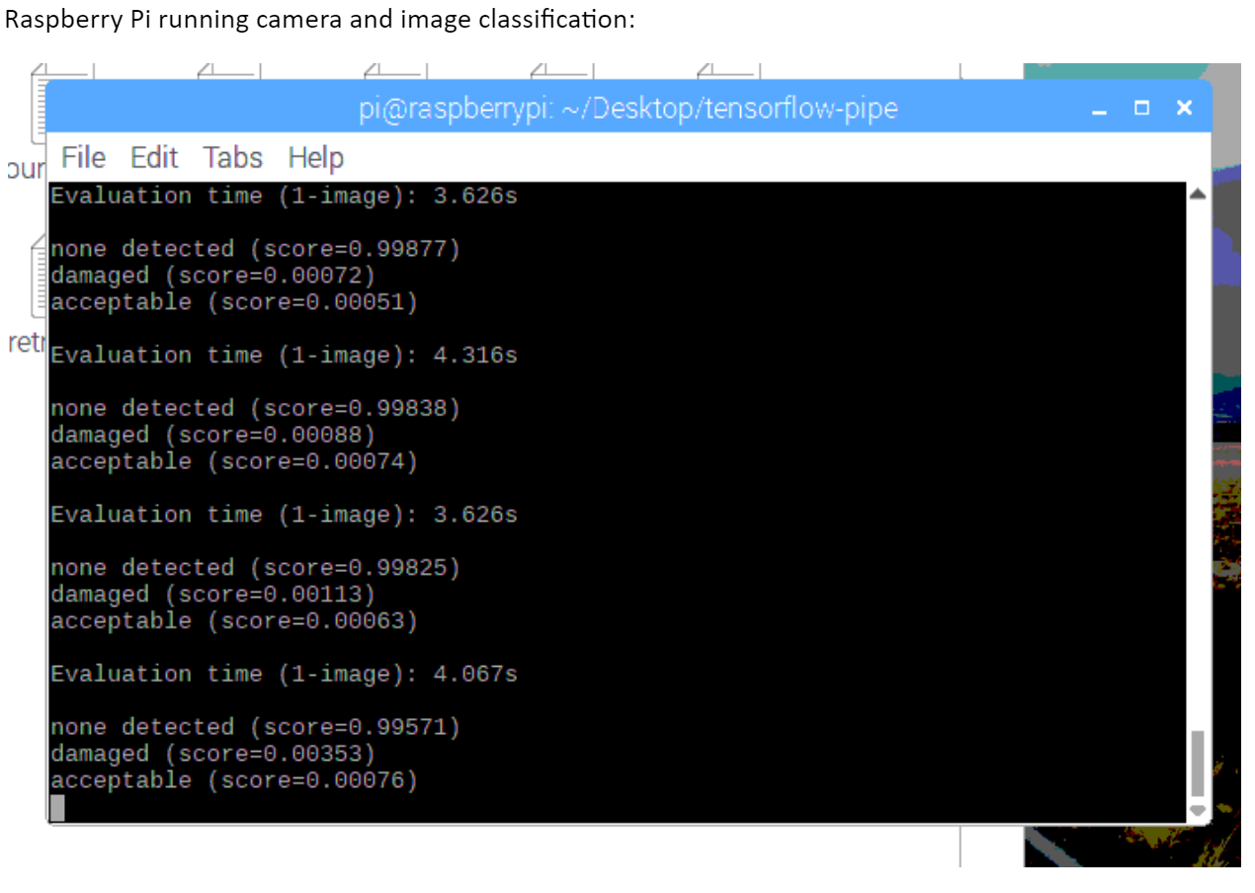
Demo

